Slide 1
Tour of the NANOOS Visualization System (NVS)
Sarah Mikulak
NANOOS Education Specialist
smikulak@uw.edu

Slide 2
Welcome to NVS!
Located at http://nvs.nanoos.org
NVS is NANOOS’s Google Maps-based portal to data and forecasts.
This tour will give you a quick run-down of what NVS has to offer.

Slide 3
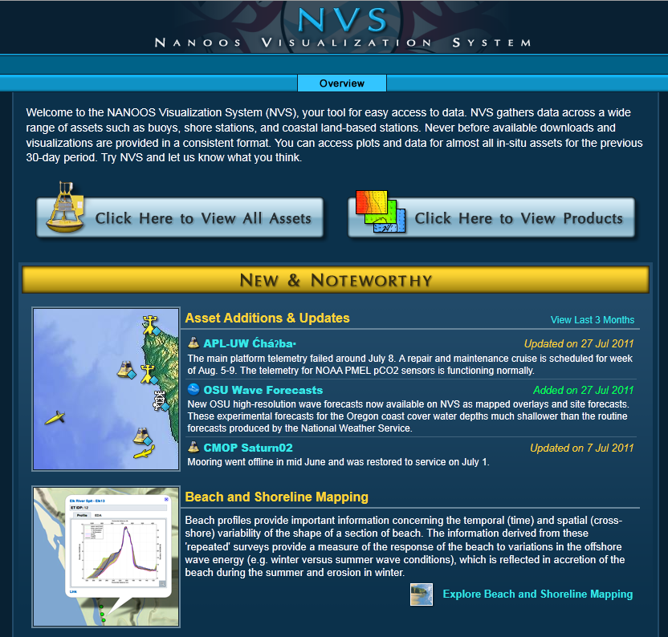
NVS Entrance Page
Click on
to see main data portal

Slide 4
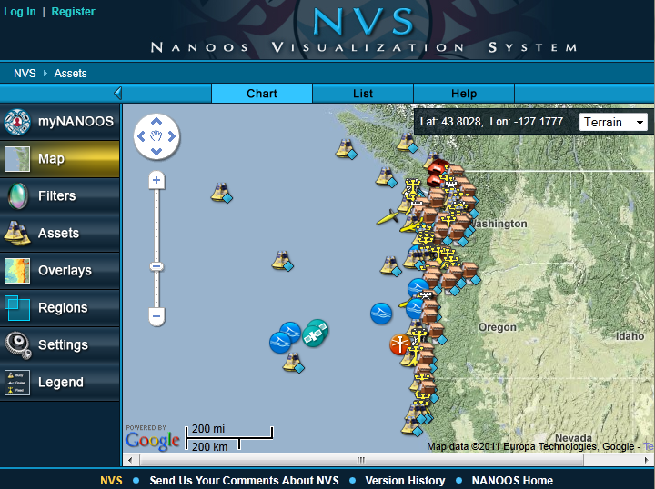
Main NVS Page
Click on any icons in the map or buttons in menu on left

Slide 5
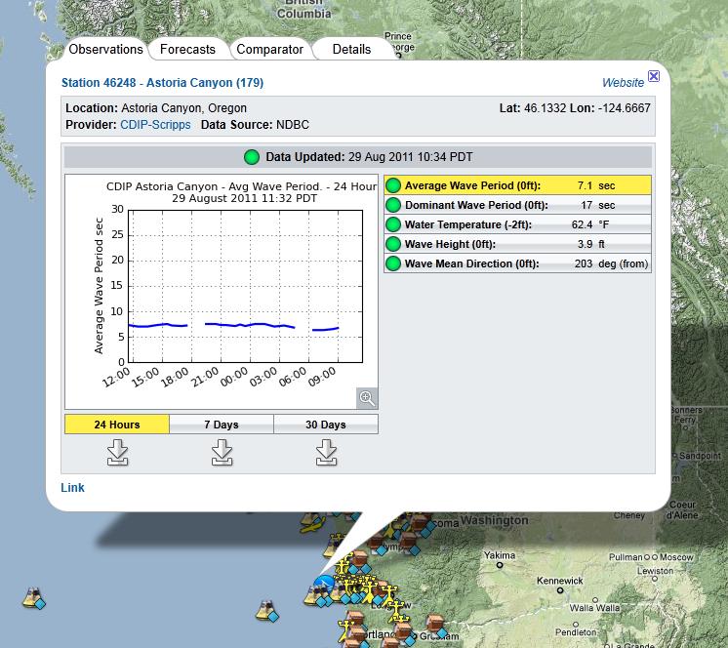
Data from an icon
Click on any icons in the map to get graphs of the past 24 hours, 7 days, or 30 days of data.
You can download the data using the arrow icons below the time-range button.

Slide 6
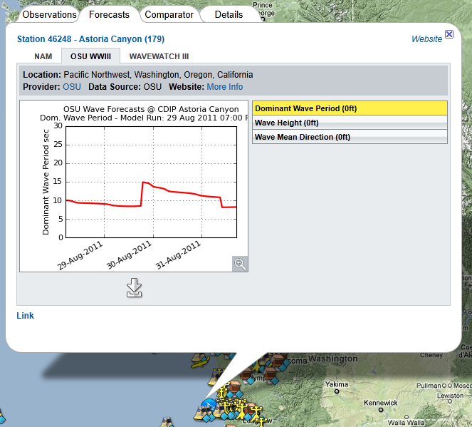
Forecasts from an icon
Click on Forecasts tab to see any forecasts from that location.

Slide 7
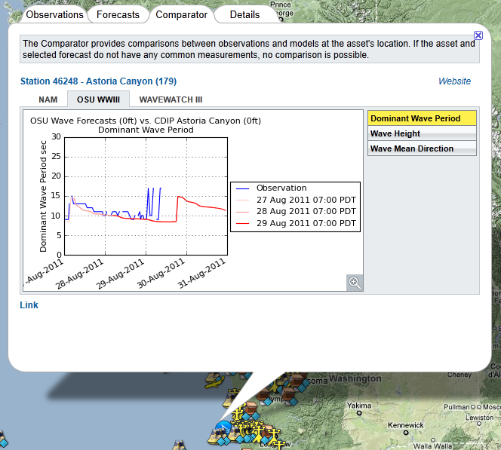
Comparator from an icon
Click on Comparator tab to see the comparison of observed data verses models/forecasts.

Slide 8
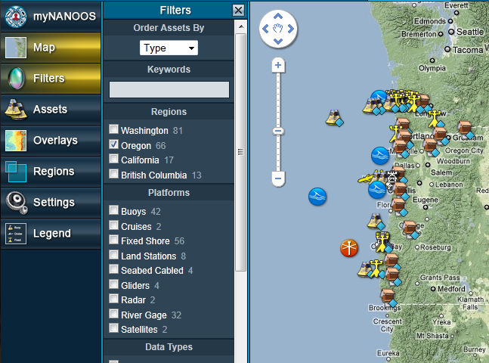
Filters button
Click on Filters to find assets (buoys, sensors, etc) that fit a certain criteria

Slide 9
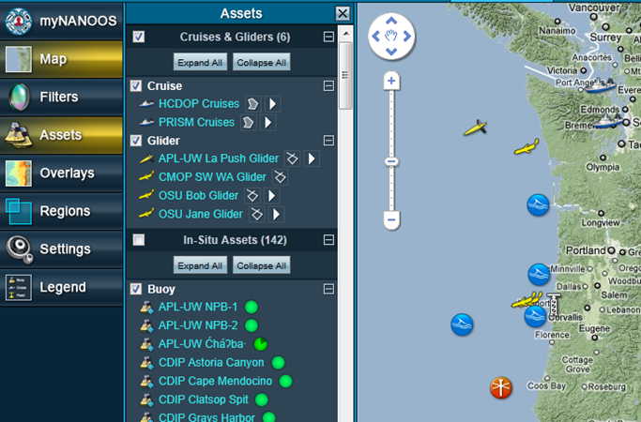
Assets button
Click on Assets to select only one type of asset, or to find a specific asset in the list

Slide 10
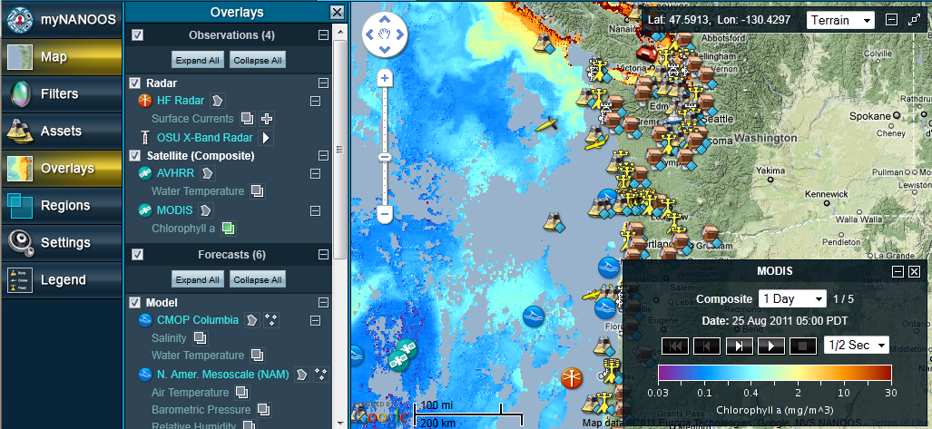
Overlays button
Click on Overlays to find data and forecasts that overlay on top of the map

Slide 11
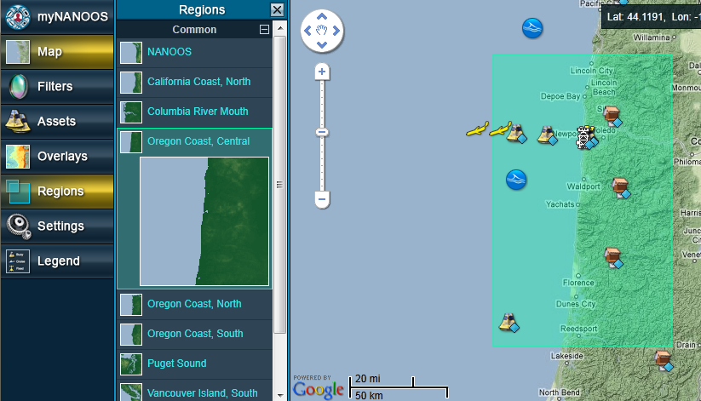
Regions button
Click on Regions to select a region to zoom in on

Slide 12
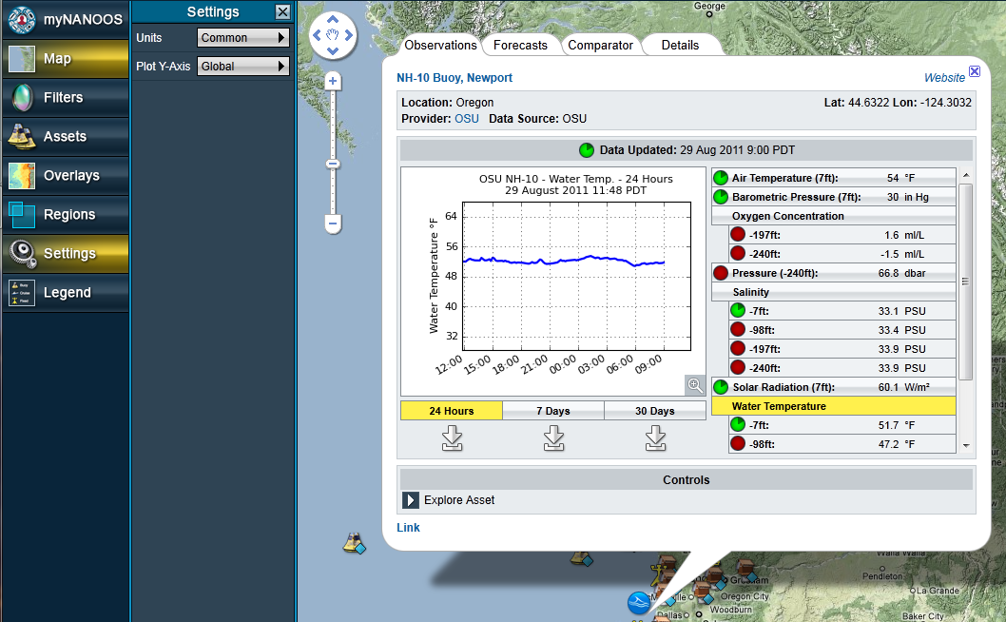
Settings button
Click on Settings to customize features and displays

Slide 13
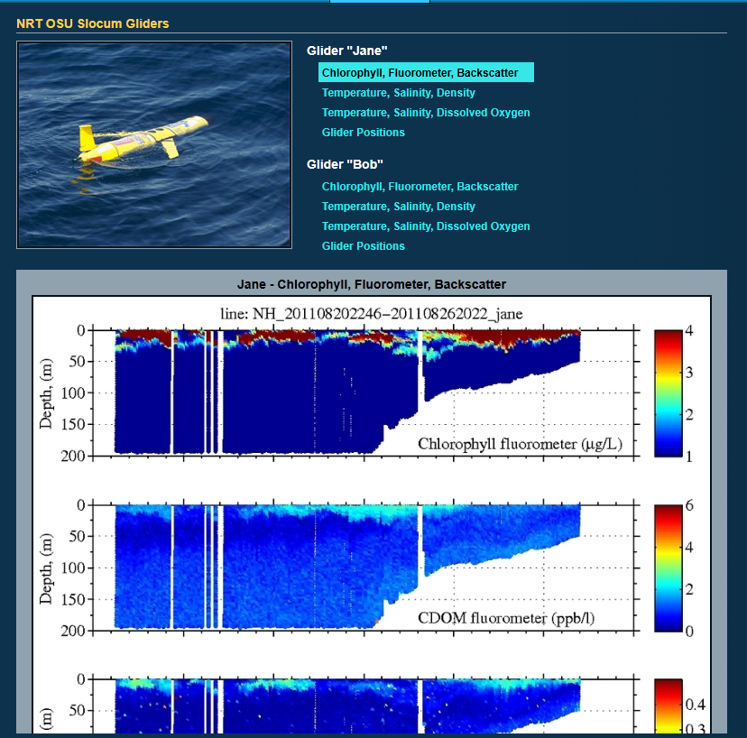
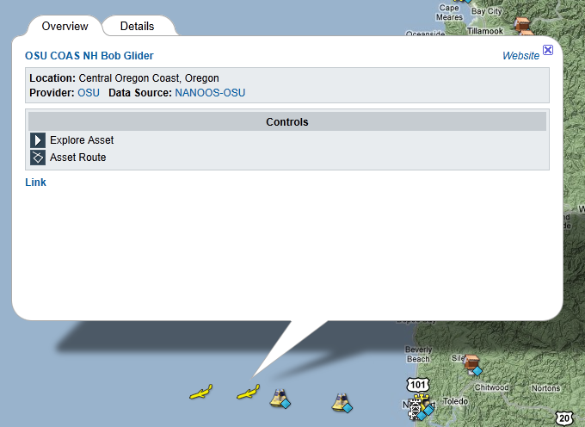
Data and forecasts near Lincoln Co.
OSU Gliders

Slide 14
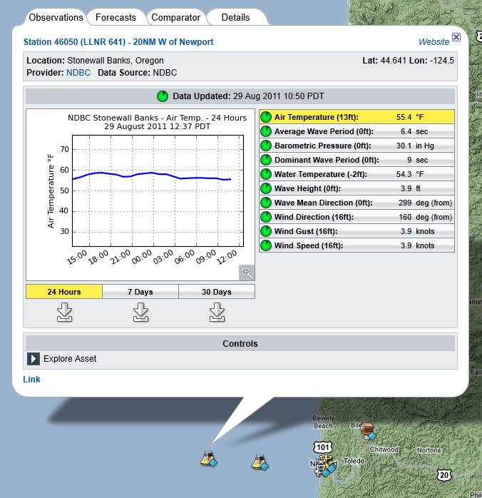
Data and forecasts near Lincoln Co.
NOAA Buoy

Slide 15
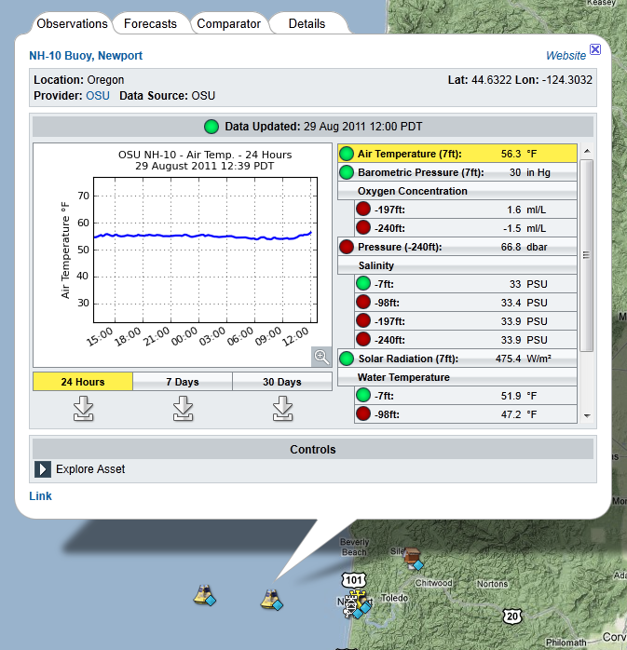
Data and forecasts near Lincoln Co.
OSU Buoy

Slide 16
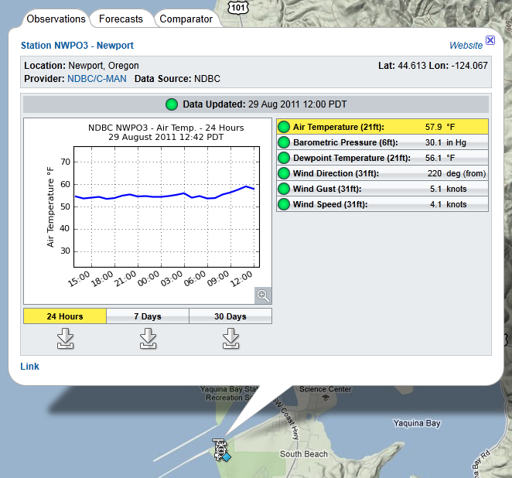
Data and forecasts near Lincoln Co.
NOAA Weather Station

Slide 17
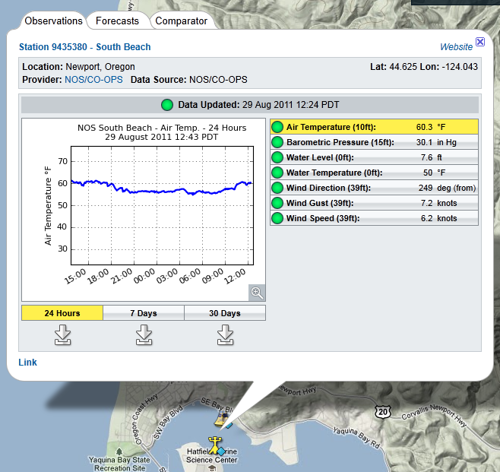
Data and forecasts near Lincoln Co.
NOAA Tide Station

Slide 18
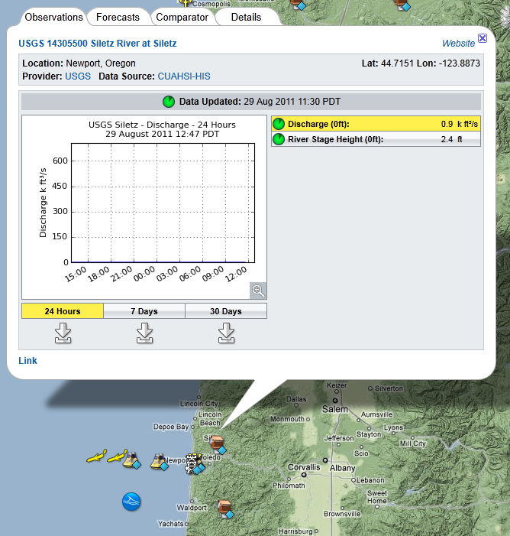
Data and forecasts near Lincoln Co.
River gauge for Siletz and Alsea Rivers

Slide 19
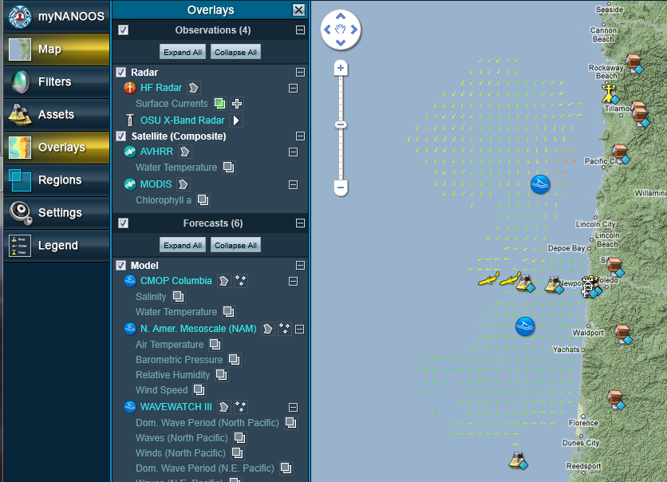
Data and forecasts near Lincoln Co.
Overlay: Sea Surface Current Data

Slide 20
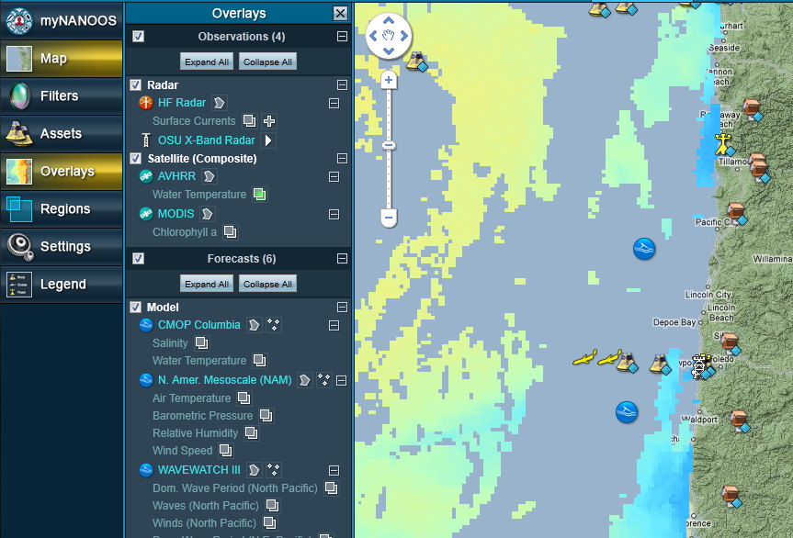
Data and forecasts near Lincoln Co.
Overlay: Sea Surface Temperature Data

Slide 21
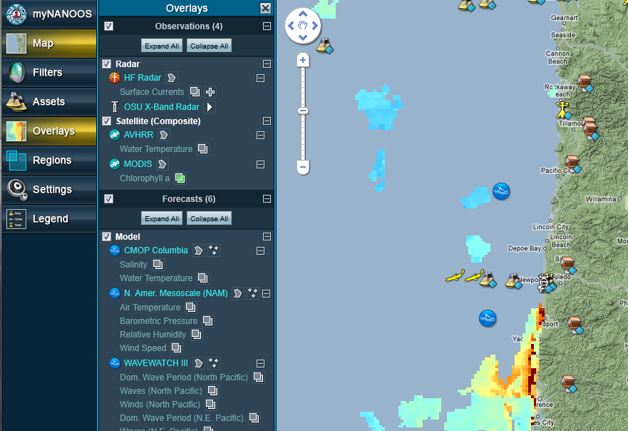
Data and forecasts near Lincoln Co.
Overlay: Chlorophyll-a Data

Slide 22
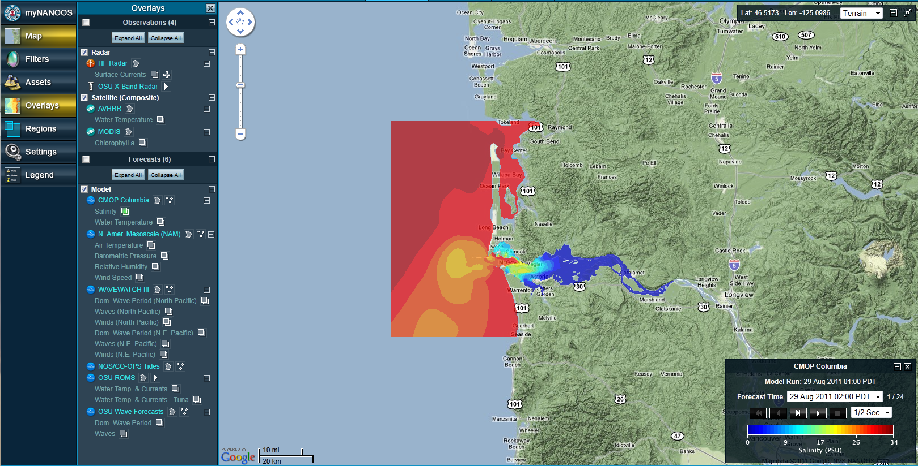
Data and forecasts near Lincoln Co.
Overlay: Columbia River Salinity and Temperature Forecast

Slide 23
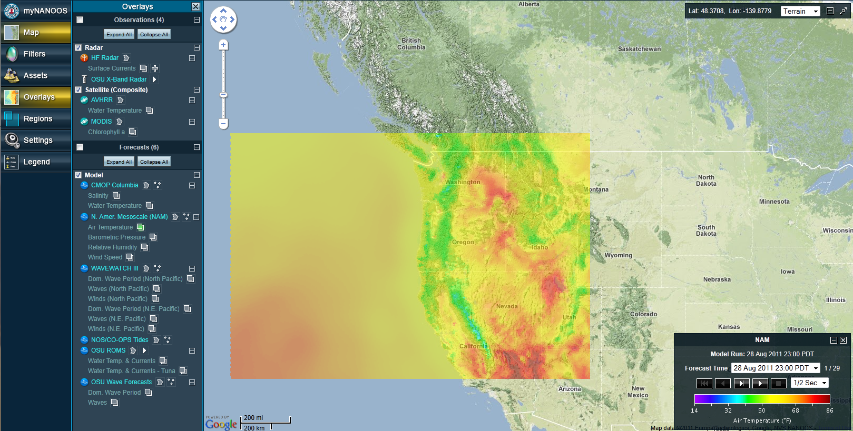
Data and forecasts near Lincoln Co.
Overlay: Air Temperature Forecast

Slide 24
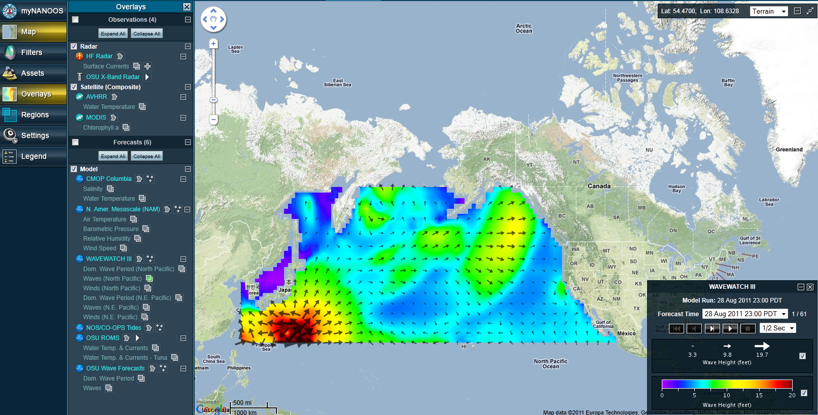
Data and forecasts near Lincoln Co.
Overlay: Wind and Wave Forecast

Slide 25
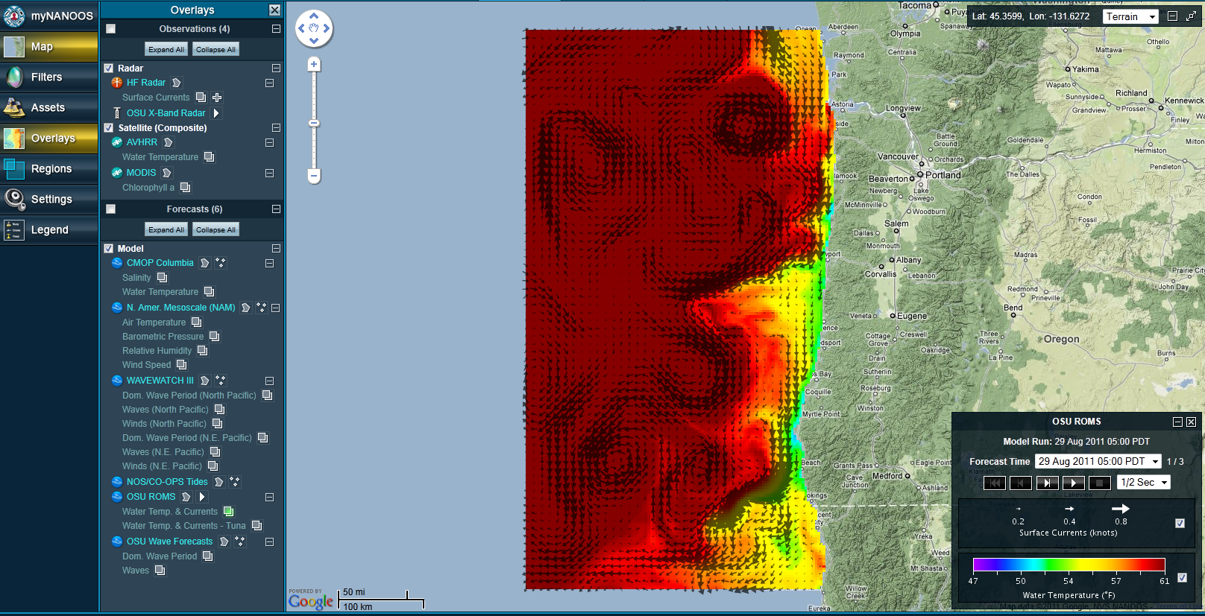
Data and forecasts near Lincoln Co.
Overlay: Sea Surface Temperature and Current Forecast

Slide 26
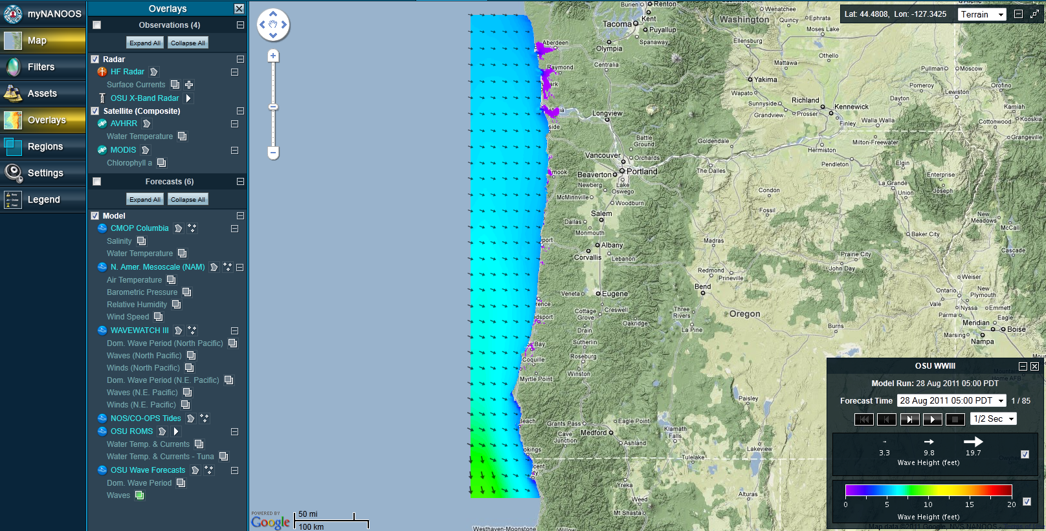
Data and forecasts near Lincoln Co.
Overlay: Wave Forecast

Slide 27
Potential Activity: Observation Journaling
Have students observe ocean directly or via webcams (http://www.northwestwebcams.com/oregon-web-cams.shtm)
Have students compare observations to data and/or forecasts from NVS

Slide 28
Potential Activity: Monitoring a storm
If a storm is forecasted, look at:
Wind and wave forecast overlays
Barometer data and forecasts
Wind and wave data during the event
Precipitation data
Salinity data in bays
Turbidity data
River and tide gauge data

Slide 29
Potential Activity: Monitoring upwelling
See NANOOS’s “Well, Well, Well” lesson plan:
http://nanoos.org/education/lesson_plans/pdfs/well_well_well.pdf

